Slide 1
Hollywood Movies Exploratory Analysis and Visualization
Yordanos Jewani
Data Wrangling and Exploratory Data Analysis(SP 2022_CAP5320.01 I&T)
April 29th, 2022

Slide 2
Introduction
I have chosen Hollywood Movie data set for analysis. This spreadsheet shows you the movies between 2007 and 2013. The dataset has 16 different columns and 970 rows of data. I will be directing the analysis towards finding answers to the questions below, and in the process hopefully stumble across new insights as well.
Questions about the data:
Which studios made the highest number of movies?
Find the genre in which there has been the greatest number of movie releases?
What are the names of top five movies with highest budget?
Find the highest rated movie in the "Love" story type?
Is there a relationship between audience rating and profitability?

Slide 3
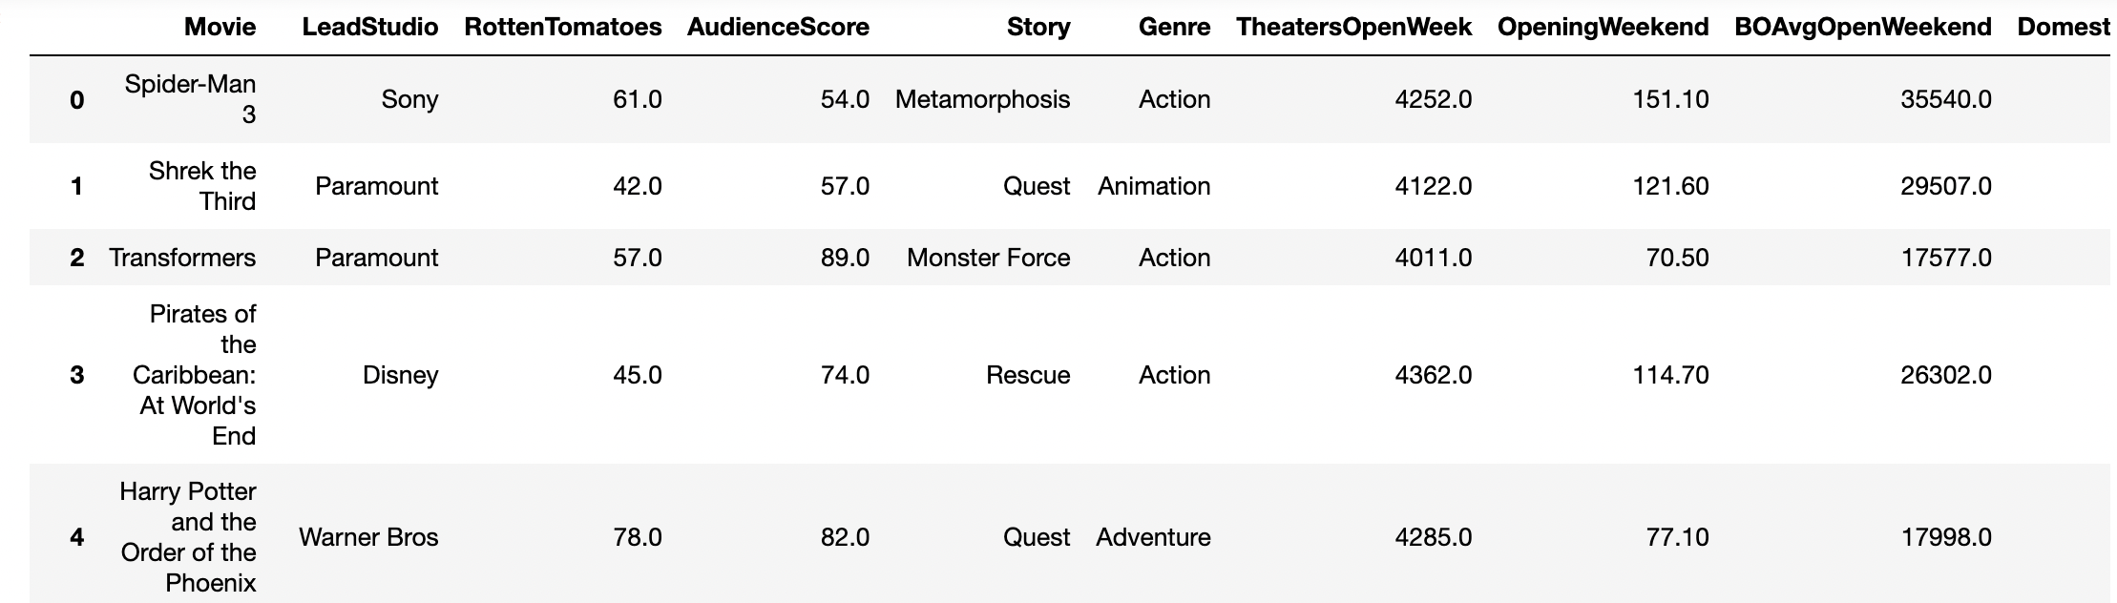
Hollywood Movies Data Set

Slide 4
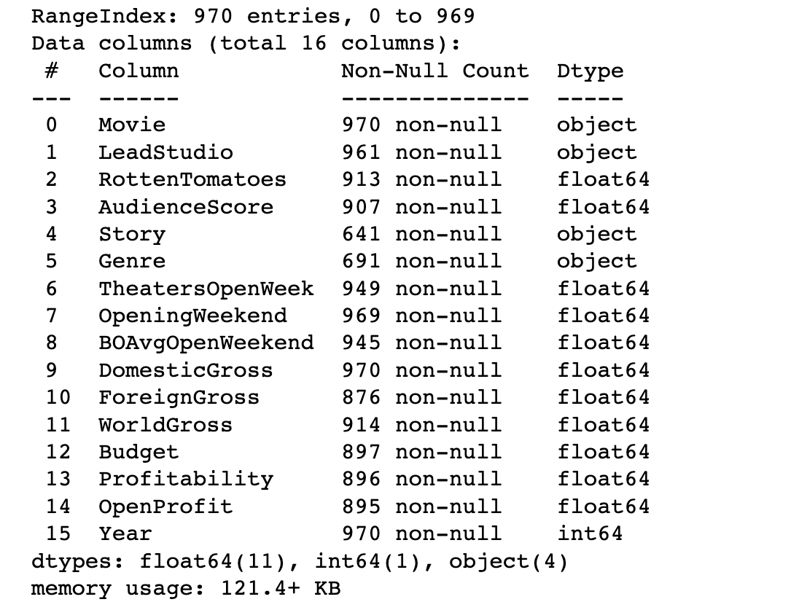
Data.info()

Slide 5
Data Cleaning
Now we'll make modifications to our dataset. First, we'll remove extraneous data and then add and replace information to ensure our dataset is clean for analysis.
Drop columns that are not relevant to the analysis.
I'm most concerned with profitability and budget rather than those columns
Remove outliers using 3𝜎 rule
Add revenue column to calculate profitability ratio.
Replace Na value for genre and story to none because I don't want to lose the observations to answer the questions above and fill na('') for numeric columns.

Slide 6
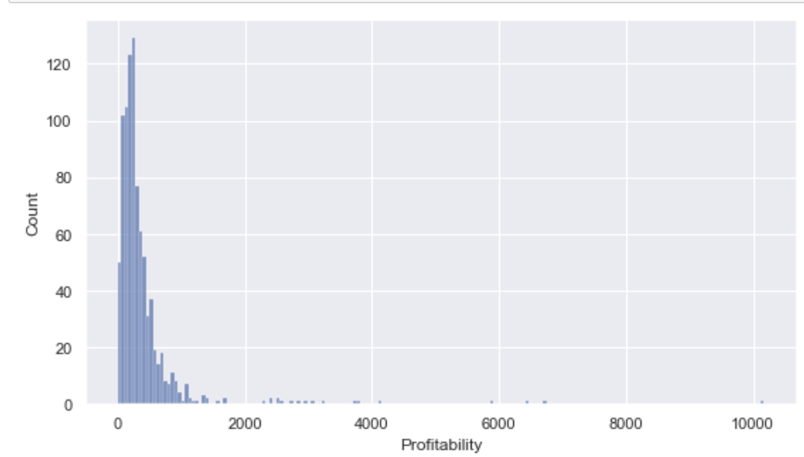
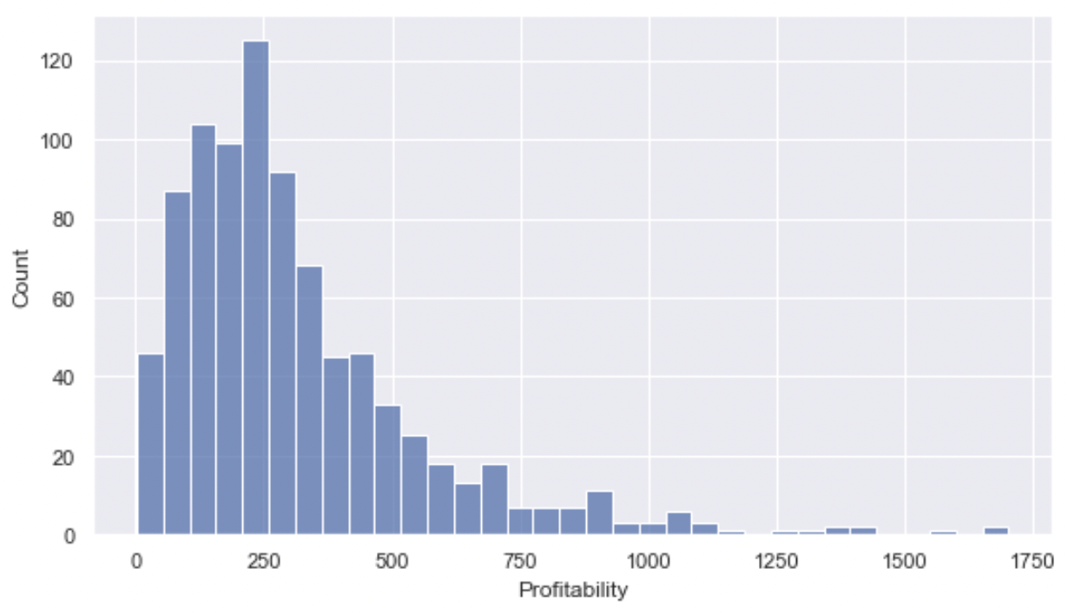
Remove the outliers using 3𝜎 rule
Before
After

Slide 7
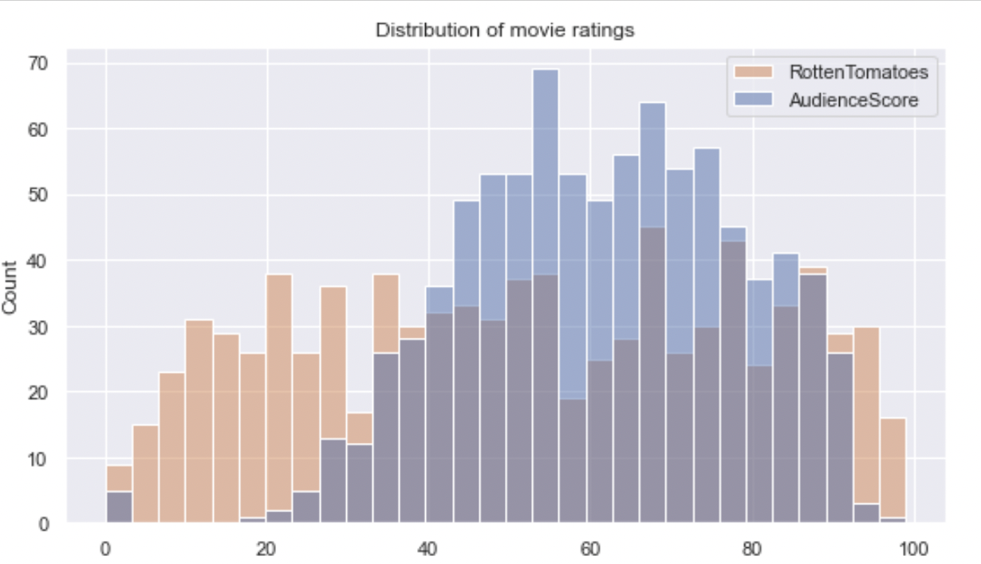
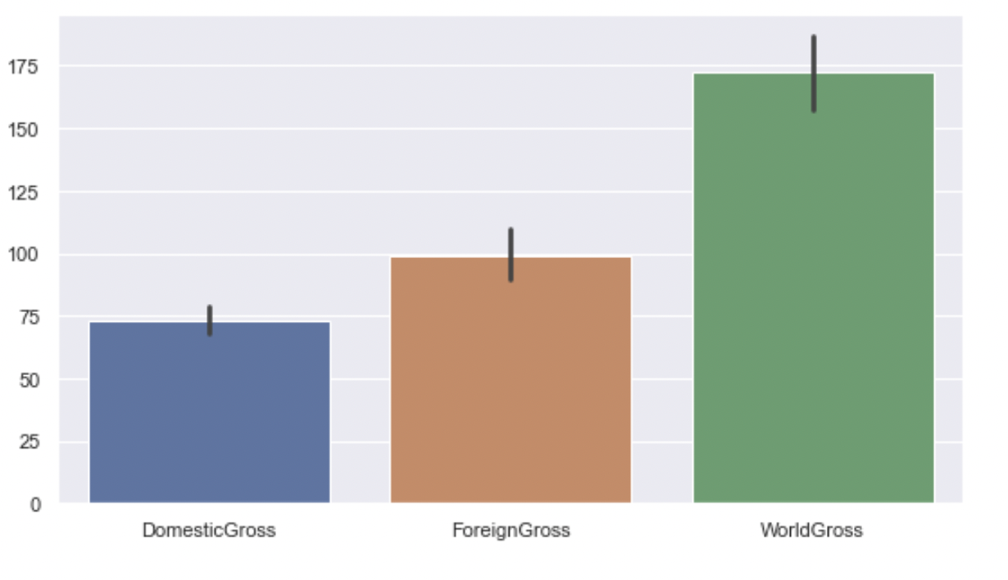
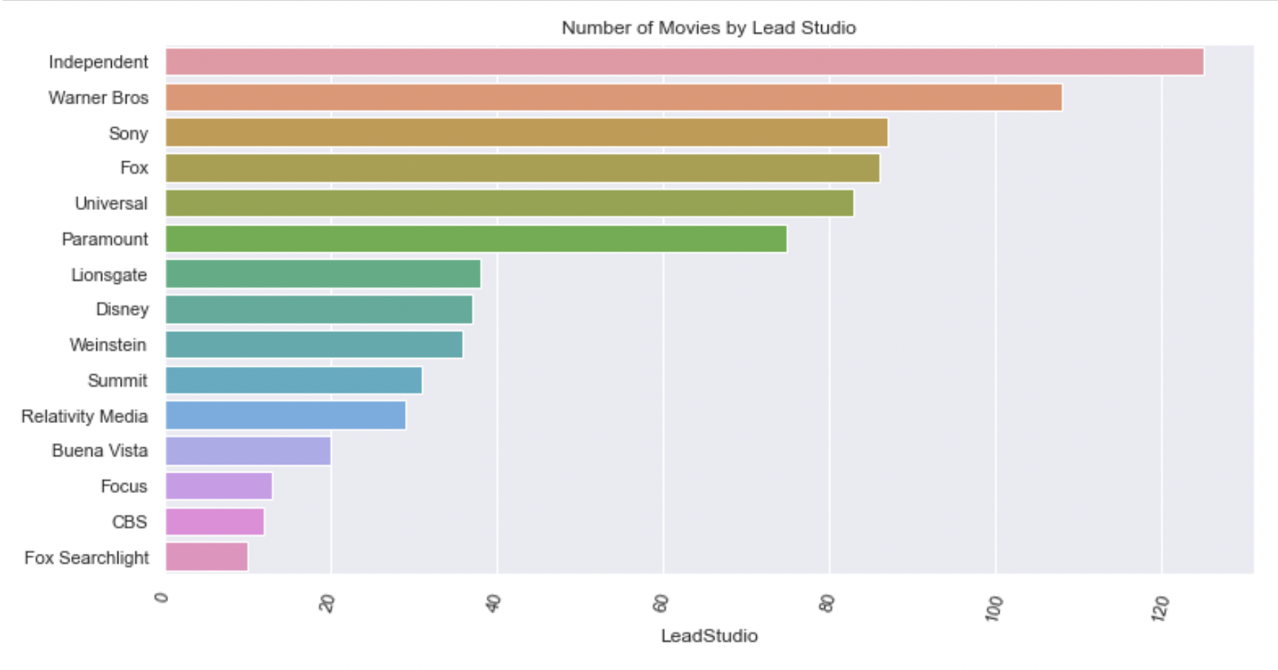
Distribution of variables

Slide 8
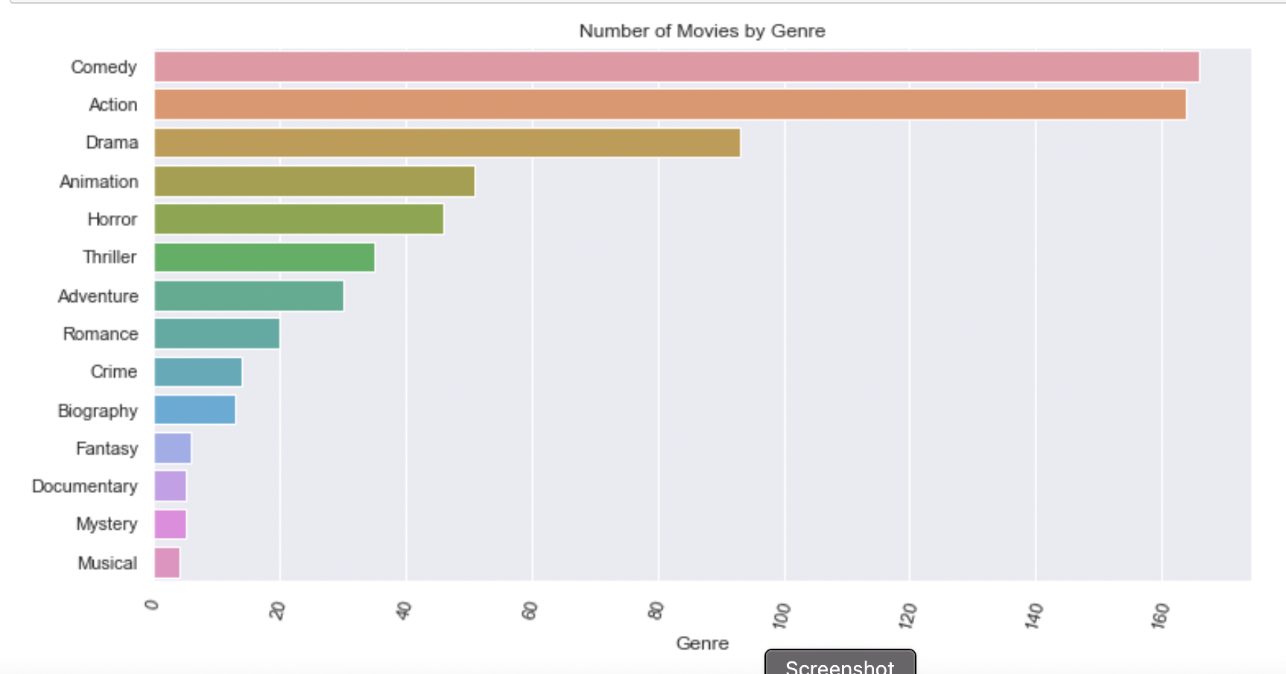
Find the genre in which there has been the greatest number of movie released ?

Slide 9
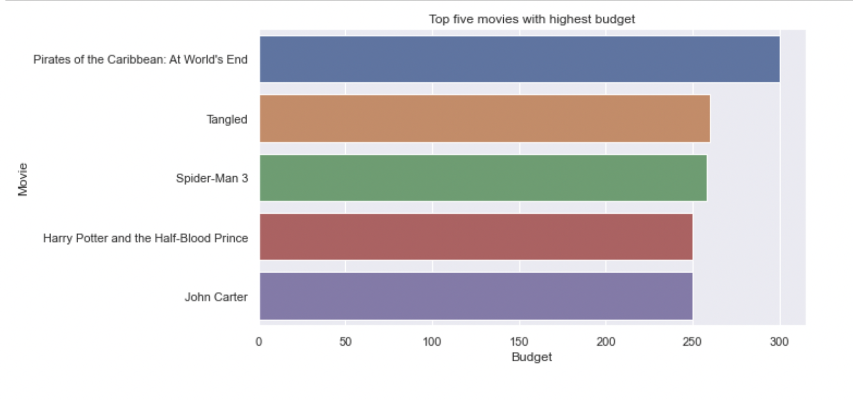
What are the names of top five movies with highest budget?

Slide 10
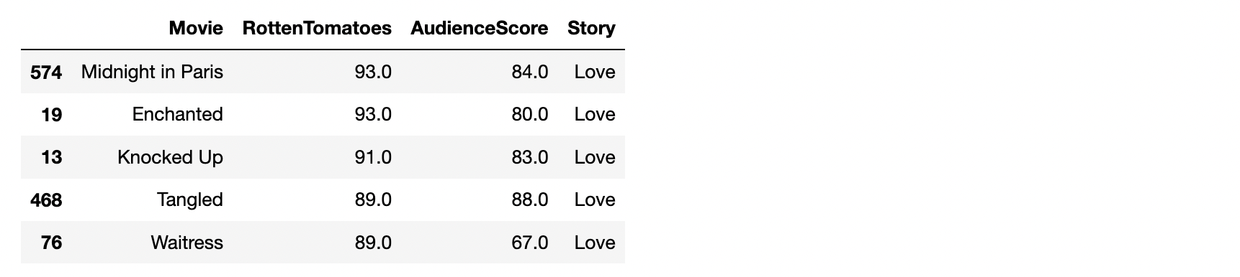
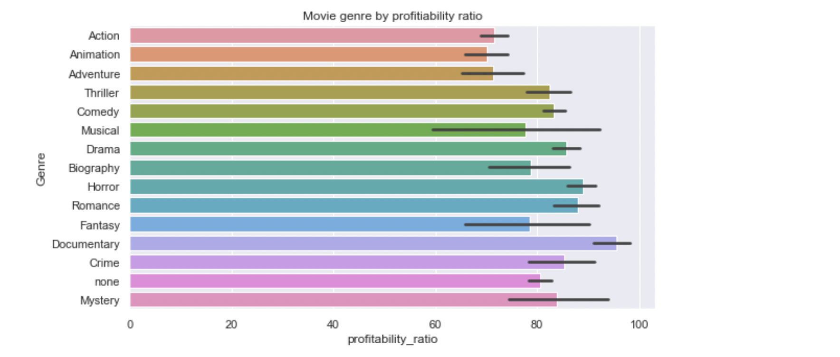
Find the highest rated movie in the "Love" story type? Which genre has the highest rating?

Slide 11
Summary
I have covered the following in the project:
Loading and cleaning dataset using Pandas
Correcting outliers using 3𝜎 rule
Visualizing relationships between two or more variables using scatter plots
Distributions of variables using histograms & bar charts to
Plotting Matplotlib and Seaborn charts
In this project, interesting thing I noticed was that Comedy movies are the most frequently produced movies, while the highest rated genre is Animation movie. so, this is something to look more into, We can just ask the reason why we produce more Comedy movies while audience rating indicate people are more interested in Animation Movies?

Slide 12
Thank You !!!

